Slide 1

Customer Relationship Management (CRM)
Introduction of Analytical CRM
Instructor: Prof. Peter Mattheis
September 2020
Presenter: Pham Ngoc Tram
Tran Ngoc Hai Dang
Notes:
hello everyone and welcome to today topic of Customer Relationship Management or CRM and my target topic of CRM will be analytical CRM where we will learn about data driven decision and how the company could make the most use of it to improve the customer benefit and drive profit. So let don’t wait any further and let me introduce you to the agenda

Slide 2

Content
CRM Overview
Analytical CRM
Driven by data
Data sources
Customer 360 View
Case Study
Q&A
References
Optional : A day of a CRM data analyst/ data science
35 Minutes
Notes:
So here is the agenda for today . We will go very briefly to the overview of CRM where I ll talk to you a little bit about the evolution of CRM , what it is now and where it is heading, . 70% of our time today will be on Analytical CRM which is the area where I often collaborate with in my company CRM team. The total time for this presentation will be about 35 mins and we will have an optional activities where we will take a look of a day as a CRM data staff. In case if I don’t have the time I will send you the video link where I talk about it
My inspiration to present to you guys these topics were from when I was observing the class introduction and about 60% of the students here are either from the analytics , consultant or managerial fields which is why I highly believe my topic in analytical crm which focus on making use of the data within an organization will highly benefit to class

Slide 3
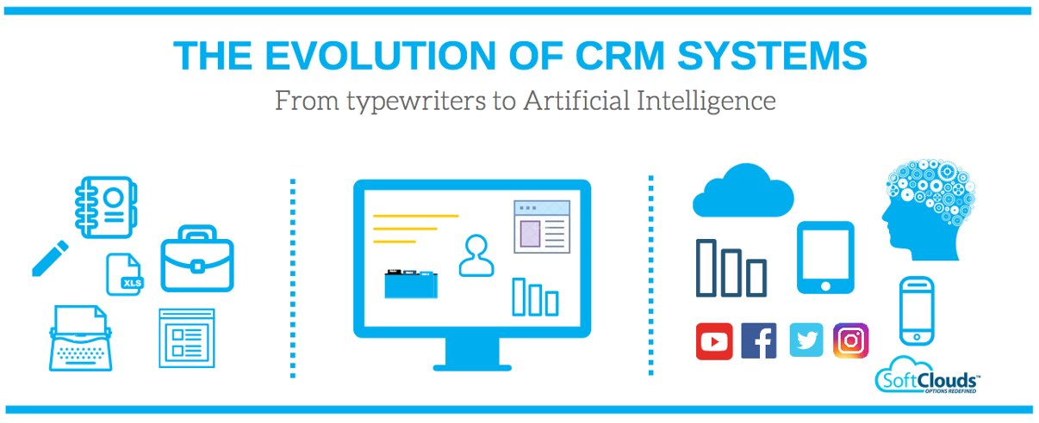
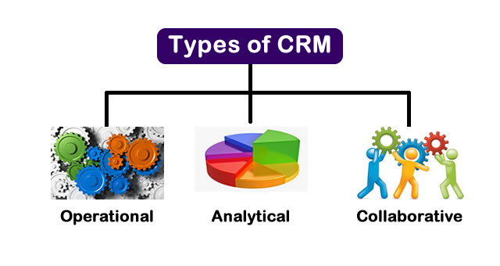
CRM Overview
CRM stands for Customer Relationship Management which is an approach to manage the relationship of the past, current and potential customers.
One important aspect of the CRM approach is the systems of CRM compile data from a range of different communication channels
It uses data analysis to understand the customers’ interaction with the company to optimize profit, growth and customer satisfaction
There are three type of CRM :
Analytical
Operational
Collaborative
Notes:
So first, let take a look at the definition of CRM and have history tour of evolution of crm after that . I am strongly believe in learning about the history will help us understand about how we got to where we are . So as I mentioned CRM stands for Customer Relationship Management , which is / an approach to manage the relationship of the past, current and potential customers...........
So now , to reflex back, managing customer relation is not a new concept. It is a concept since the dawn of men when people start trading with one another and shop keepers always have a ledger book where they keep information of all of their customers and pay attention to their value customer, could be Mr. Joe who has contribute to 20% of their store sale. So moving to the age when computer and data storage become accessible, we now could store the customer data in database, data warehouse and visualize different trends and relationship on tools such as power bi , tableu , which you might have heard as tools for data visualization. And where we are heading next ? It is the evolution of cloud, data lake , data mesh , and where customer information is not only connected from the sales and marketing department but also from so many different channel : fb, instagram, pinterest, and in so many form: txt messages , audio , phone calls with a vast volume . So how do we make the use of it ? It s the power of analytical CRM
So let go back a bit, now you took the history lesson, I want to bring your attention to 3 type of CRM . So we have 3 type :
Analytical CRM focuses on intelligent mining of customer related data for
strategic and tactical purposes (main focus is to find out ways to improve
customer satisfaction and retention rates)
• Operational CRM: focuses on the automation of customer facing
processes to facilitate like selling, marketing and customer service
• Collaborative : Collaborative CRM applies technology
across organizational boundaries to enables smooth communication and transactions among businesses. Sometimes . it enables an organization to collect, organize, and share customer information across multiple teams, it is called strategic crm
Operational and analytical crm uses similar approach but address different problems. The major difference is that operational CRM is focused on customer-facing processes, while analytical CRM is more attuned to developing the organization’s systems through customer insights.

Slide 4
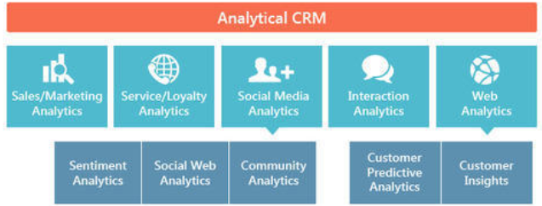
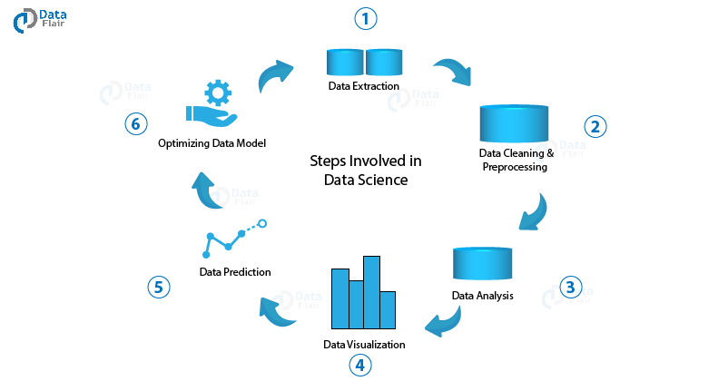
Analytical CRM
Analytical CRM focuses on intelligent mining of customer related data that collected from these channels for strategic and tactical purposes
Some of the common steps in analytical crm are : data extraction, data cleaning & preprocessing , data analysis , data visualization, data prediction, optimize model
Not all analytical CRM use Machine Learning / Data Science method
Notes:
For today session, a lot of the concepts will be related to the analytical crm
So lets repeat the concept of analytical CRM again ,
It is the ability to be able to track a range of customer actions and events over time using data from operational CRM ( as you can see in this diagram on your right here , you can see the flow of it ) . It uses traditional business intelligence (BI) methods such as data warehouse, data mining, and online analytical processing systems determine customer satisfaction and active measures to optimize the corresponding parameters
Some of the common steps in analytical crm are : data extraction, data cleaning & preprocessing , data analysis , data visualization, data prediction, optimize model
Some of the goals at the end of the cycle could be , we have a predictive modelling –like lists of customers most likely to respond to a marketing campaign , or Purchase pattern recognition – compare customers with similar behaviours – for positioning products
Not all analytical CRM use Machine Learning / Data Science method, there are traditional techniques that could still be use for example the RFM technique where can find their most valuable customers through “RFM” Recency, Frequency, Monetary value. However , my presentation today will focus on the newer concepts and method of analytical crm where people make use of external , internal data and data science

Slide 5
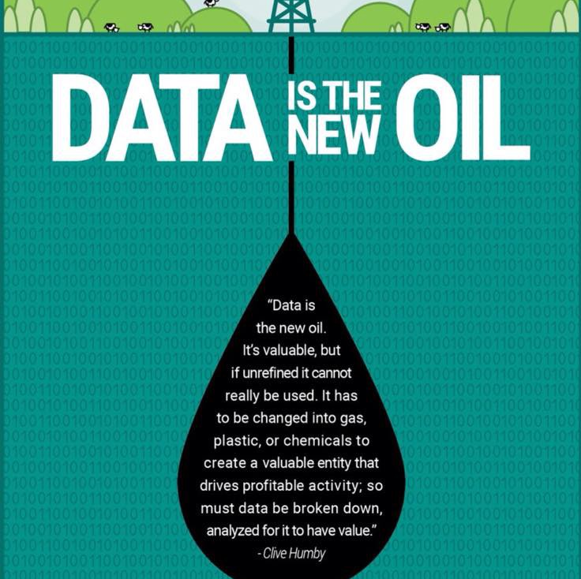
Analytical CRM driven by data
To use it, we need to
mine it
extract it
refine it
give it a purpose to serve
Notes:
So you might have heard the term data is comparable with gold or oil because nowadays, a good data will give your business an insight that give you a competitive edge, but in order to use it you need to mine it, extract it , refine it , give it a purpose to serve, just like oil or gold , you need to extract it from the ground and give it a life , whether it is petrolium, vaseline, gas

Slide 6


Case Study
Netflix
80% of what you watch next is influenced by Netflix
Amazon
35% of Amazon's revenue are generated by their recommendation system which use predictive models built from analytical data
Customer behaviors on Internet.
“like” on social media (Facebook, Instagram)
Search on search engines (Google, Bing)
The email, push notification you opened.
Conversation in chat.
Notes:
So to prove to you that analytical crm and data driven analytical crm is important , I want to bring your attention to these 2 case study
before I proceed to this slide, please let me know in the chat if you don’t know what amazon / Netflix business does?
Ok , so let proceed as we all know about netflix and amazon
- 80% of what you watch next is influenced by Netflix
- 35% of Amazon's revenue are generated by their recommendation system which use predictive models built from analytical data
So let this sink a bit and have a hard thought on this . Netflix , they know about your interest so well that out of 10 movie you watch, 8 movies are from what they learnt about you , that make you keep coming back 8 more times. Imagine this , if they didn’t do this and you have to manually searching for what would be interested to you , which is the way how blockburster was operated, would you be even come back to watch these 8 movies after hours finding what you like
Amazon case , 35% of their revenue, think about it , it is 1/3 of their revenue is from recommend things that you don’t even know you might need it yet. And how do they do that,
Customer behaviors on Internet.
“like” abd search when you install your plugin ,
and so much more through your subscriptions, behavior patterns
And that, lady and gentlement , is why analytical crm with AI is so powerful. For amazon, their system is so success that they offer their recommendation system as a service for other company to use on their cloud

Slide 7
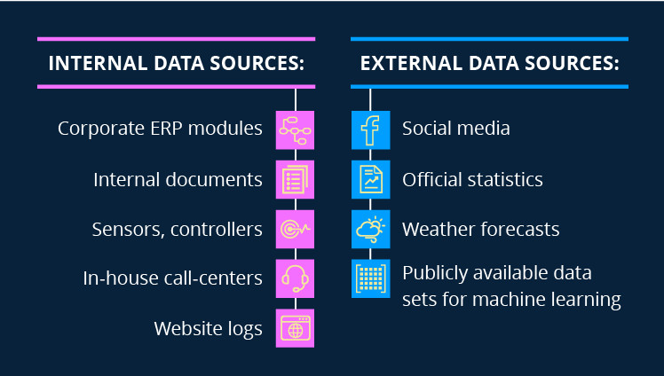
The sources of data
Notes:
So now we have taken a look at the business side, lets talk about some tech terms here . And I will try my best to make it as easy to understand as possible and only skim through it as a highlight
So in this section we will talk about different data sources , the reason why I want you to understand about the different data sources is because it will explain why we now use data science / ai –
So lets first talk about internal data sources and external data sources : in every company we have 2 sources ….
So now to get back to

Slide 8
Customer 360 View

Slide 9
A day of a CRM data analyst/ data science
Important Vocabs :
Unsupervised learning: when you want to find the hidden structure of the data, with no pre-existed label and with a minimum of human supervision
Supervised learning is designed to learn by example, which is why in supervised learning there is always a pre-existed label data. The name indicates the present of a supervisor to teach the machine to recognize the structure of the data
Content links :
Video clip : https://youtu.be/TqI9MYTvls4
Notebook :https://github.com/tramchip/-finding_donors/blob/master/finding_donors.ipynb
English : https://www.kaggle.com/willkoehrsen/start-here-a-gentle-introduction#Exploratory-Data-Analysis
Vietnamese : https://www.kaggle.com/phamdinhkhanh/home-credit-default-risk
Notes:
CRM combines with Artificial Intelligence : so as you have learnt of all the sources of data , you can see that our data have expanded from data that gathering from sales / marketing department only to data that are collected from all kind of sources – which is what we . And it would be very inefficient to have a data anlyst to mannually analyze that vast amount and to detect a pattern, sometimes we have streaming data such as ecommerce data, as in amazon case where we have to make a decision on spot so there is no time for data analyst to collect the data and analyze it and visualization
So firstly , artificial intelligence is an umbrella term for machine learning, data science . So to be general I refer to use AI here

Slide 10

Summary
CRM manages the relationship of the past, current and potential customers.
Analytical CRM uses data analysis to understand the customers.
Data is the fuel/oil for Analytical CRM
Case study: Netflix and Amazon
Data from internal and external sources
Customer 360 View
Artificial Intelligence in CRM

Slide 11
Question and Answer
Thank you for your attention
Notes:
Highlight recommend materials

Slide 12
Resources
The High Roller Experience, ISBN: 9781259862953
Customer Relationship Management: The Bottom Line to Optimizing Your ROI, ISBN: 9780130990693
https://www.wired.com/insights/2014/07/data-new-oil-digital-economy/
https://www.scribd.com/document/425923791/Analytical-CRM-1
Integrated Business Information Systems: A Holistic View of the Linked Business Process Chain ERP-SCM-CRM-BI-Big Data
Notes:
Highlight recommend materials

